Slide 1
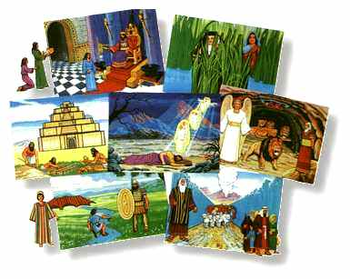
BIBLE
OVERVIEW

Slide 2
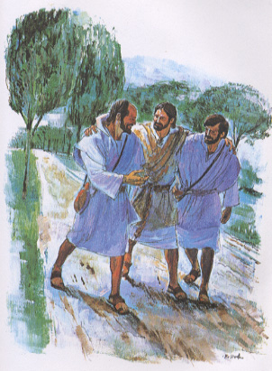

Slide 3

GOD

Slide 4


Slide 5
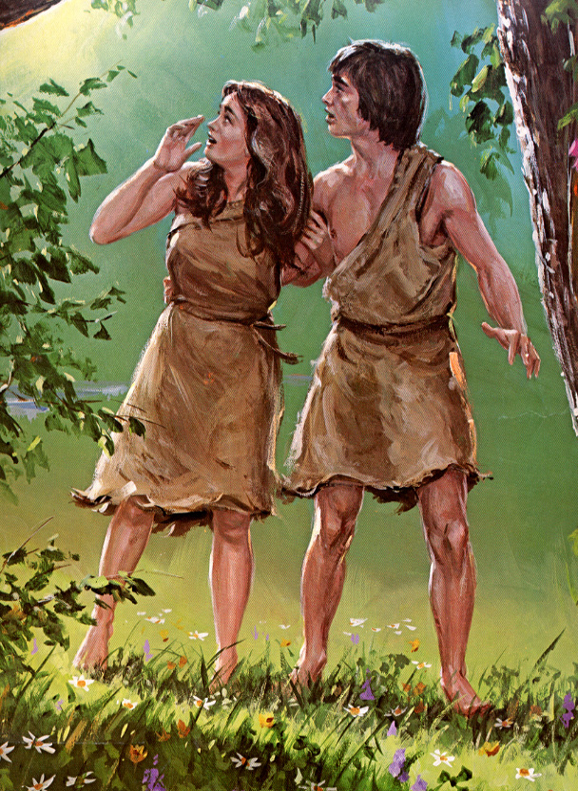
Adam & Eve

Slide 6


Slide 7


Slide 9
Adam & Eve

Slide 10

Adam & Eve

Slide 11


Slide 12
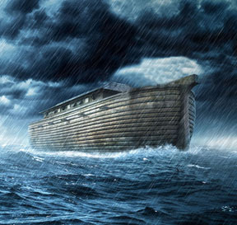
Noah’s Ark

Slide 13
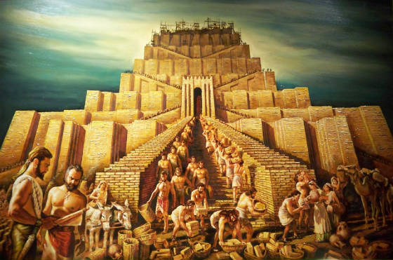
Babel

Slide 14


Slide 15
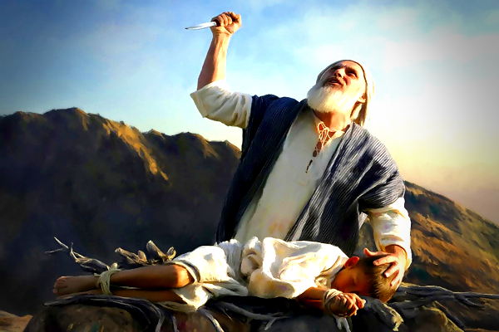
Isaac

Slide 16
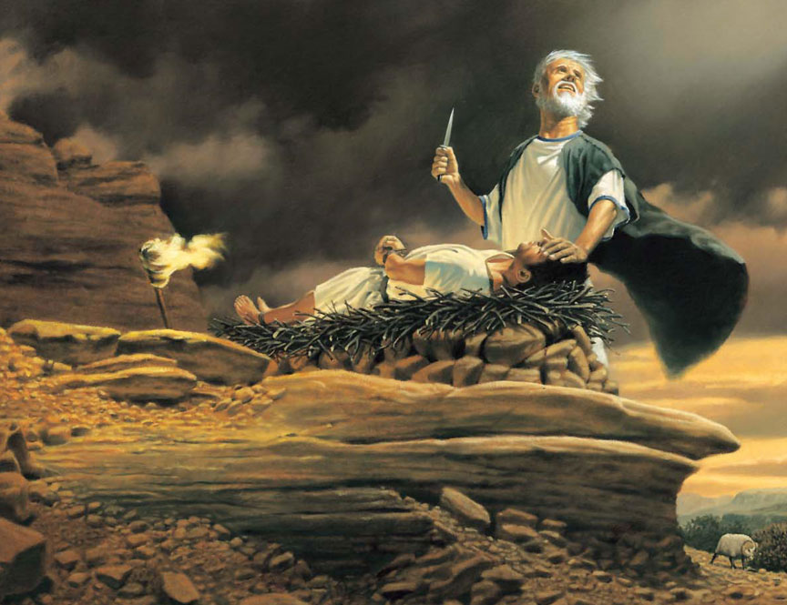
Isaac

Slide 17
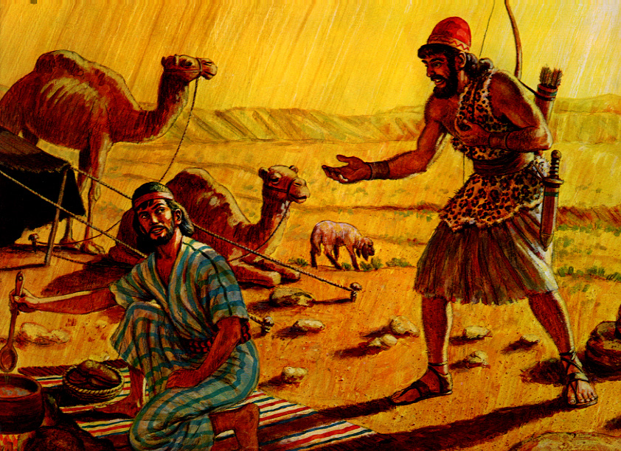
Jacob

Slide 18
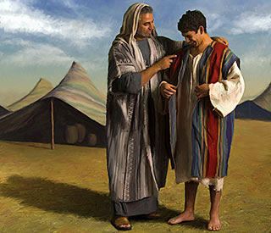
Joseph

Slide 19
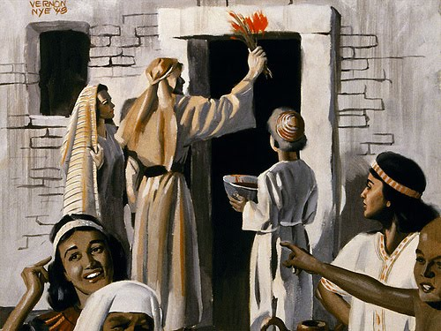
Moses

Slide 20
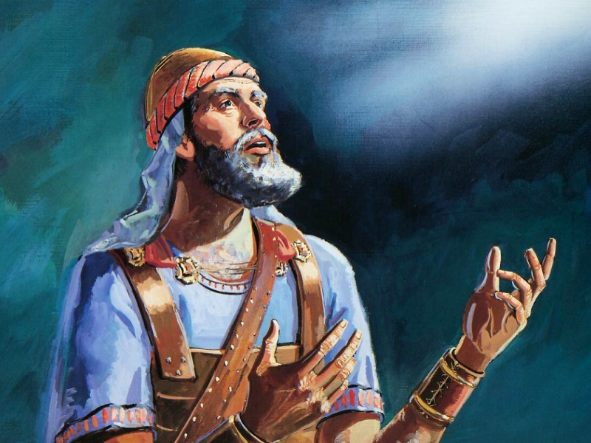
Joshua

Slide 21
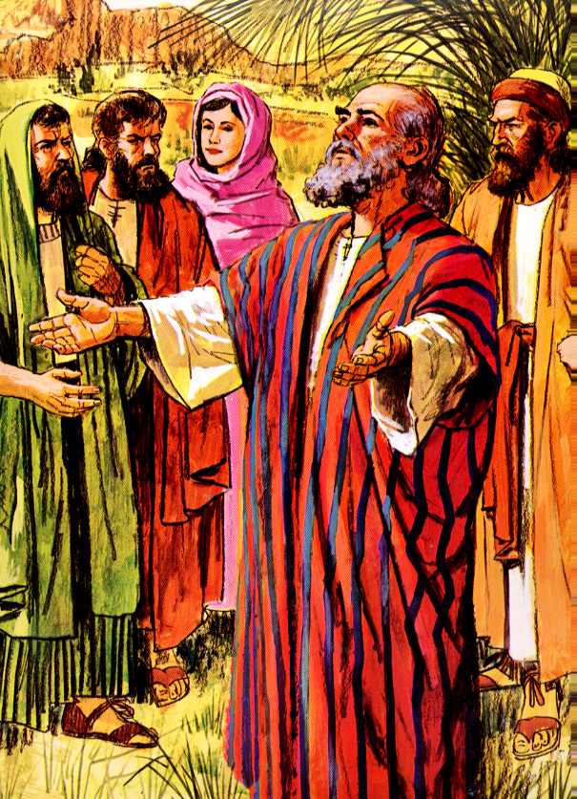
Samuel, Judges

Slide 22
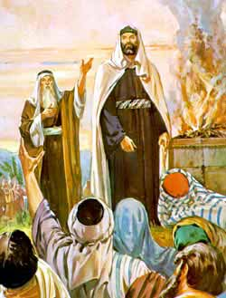
Saul

Slide 23
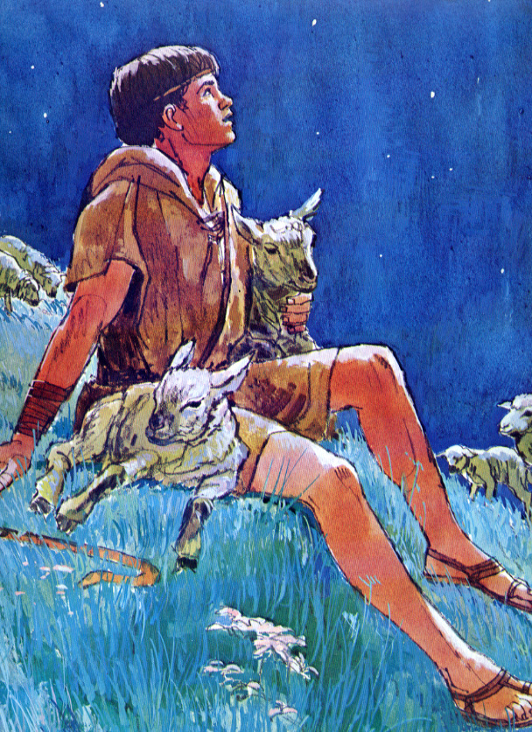
David

Slide 24
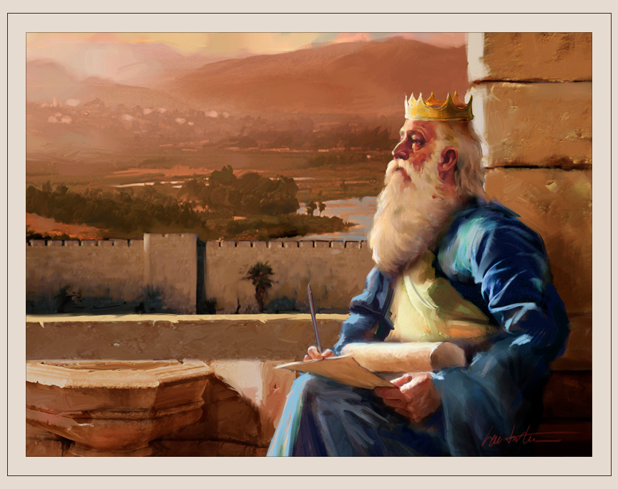
Solomon

Slide 25
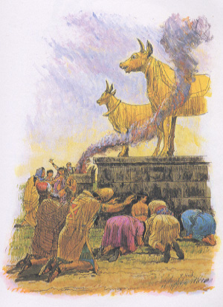
Split

Slide 26
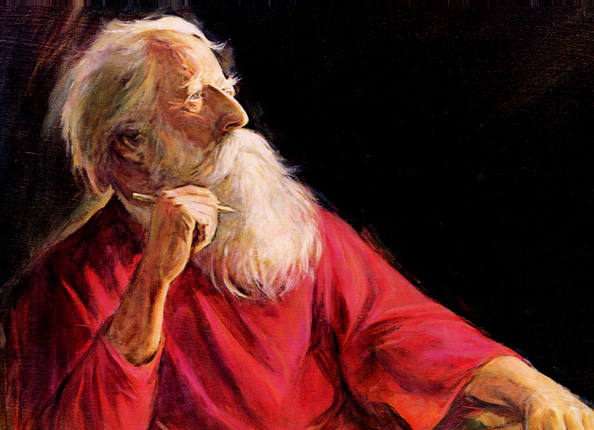
Prophets

Slide 27

Israel to Assyria

Slide 28
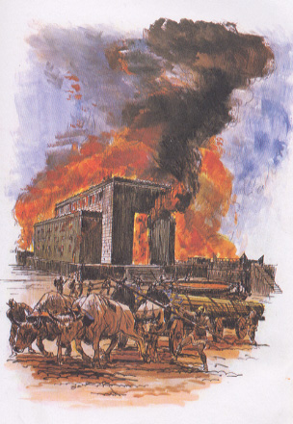
Judah to Babylon

Slide 29
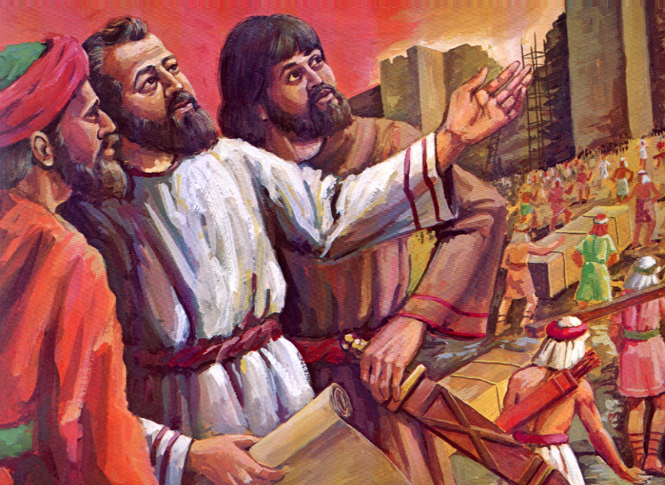
Ezra

Slide 30
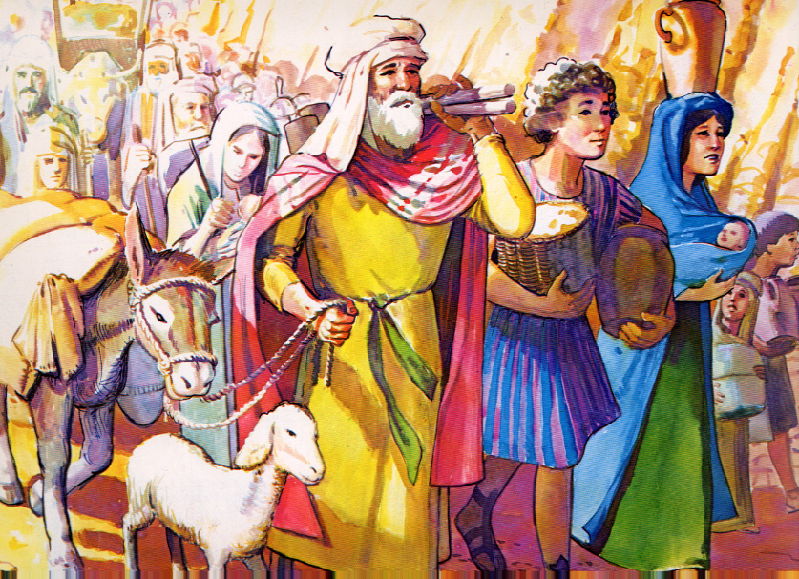
400 Silent Years

Slide 31
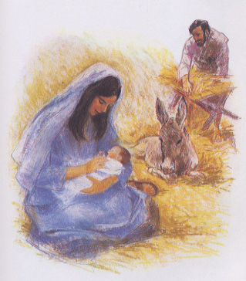
Birth

Slide 32
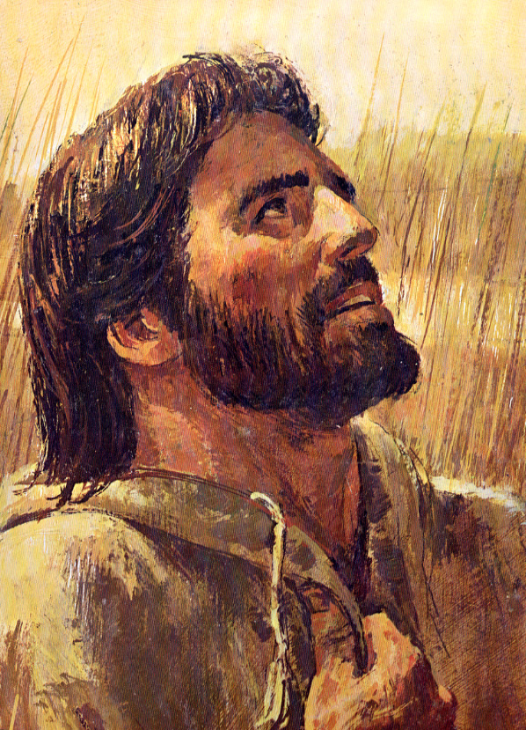

Slide 33
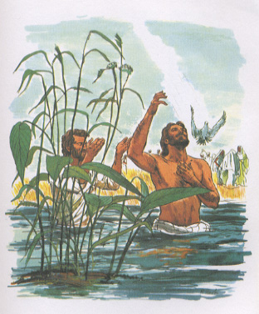
Baptism

Slide 34
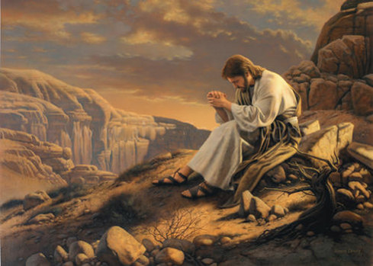
Temptation

Slide 35
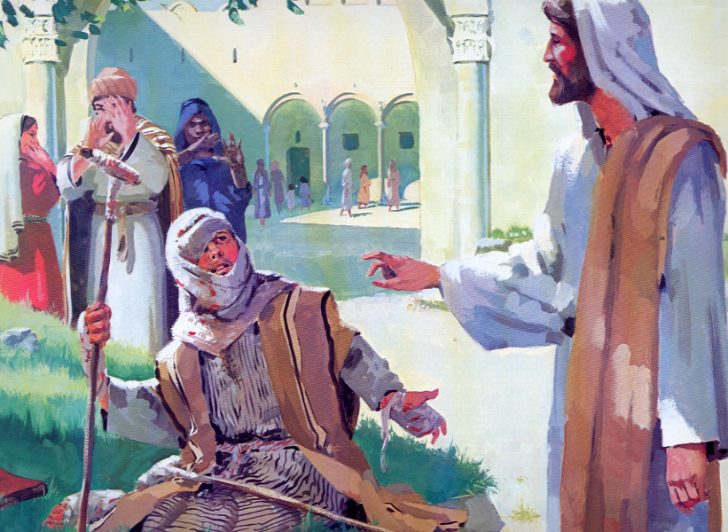
Miracles

Slide 36
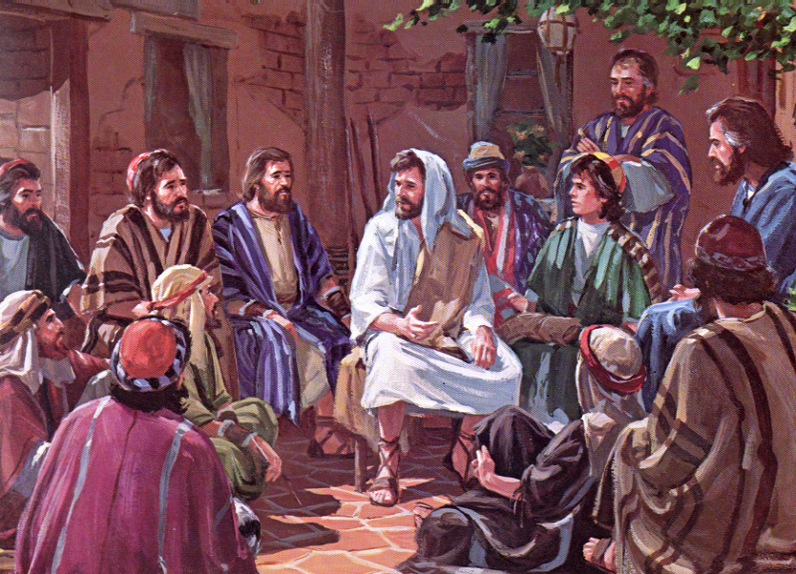
Teaching

Slide 37
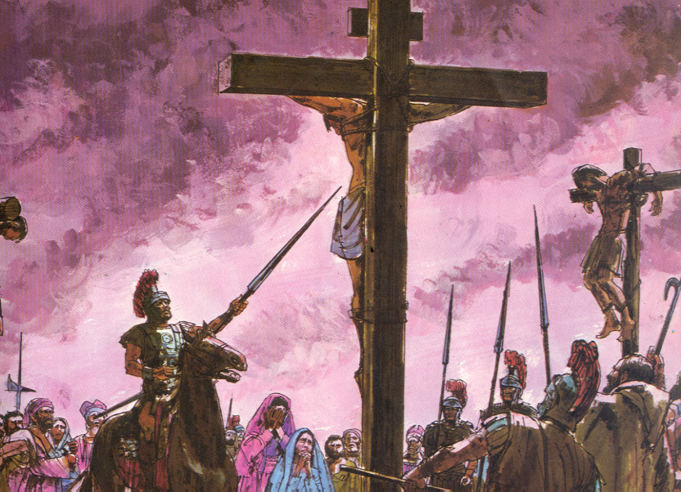
Crucifixion

Slide 38
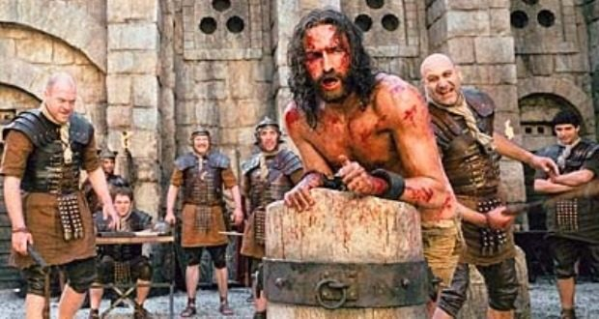
Crucifixion

Slide 39

Crucifixion

Slide 40
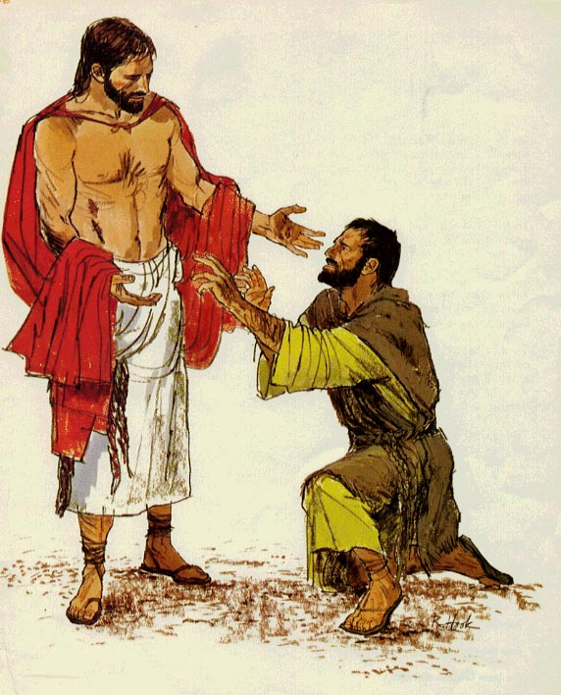
Resurrection

Slide 41
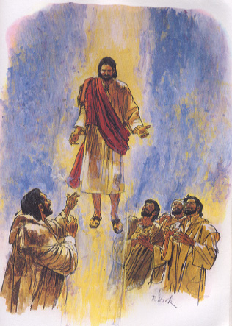
Ascension

Slide 42
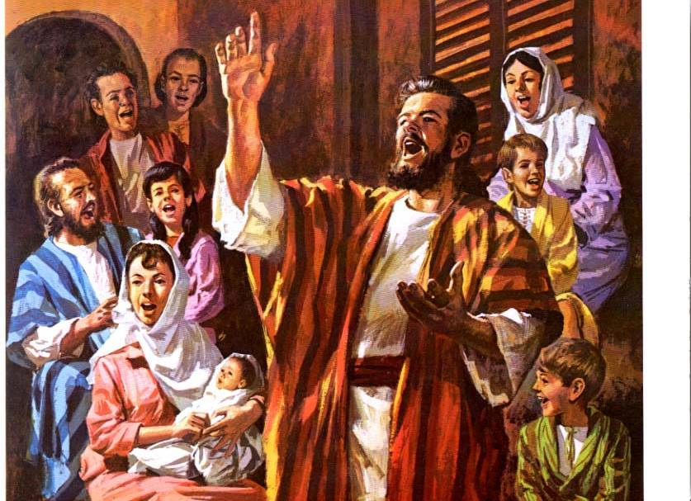
Peter

Slide 43
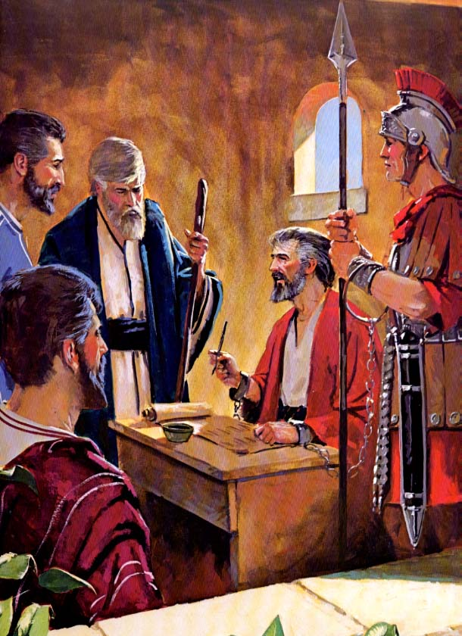
Paul

Slide 44

Church
Age

Slide 45

Rapture

Slide 46
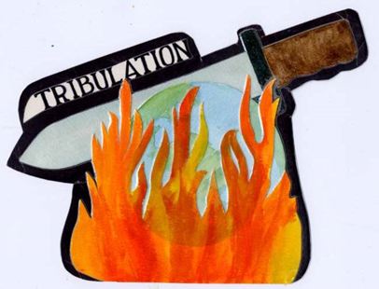

Tribulation
Millennium

Slide 47
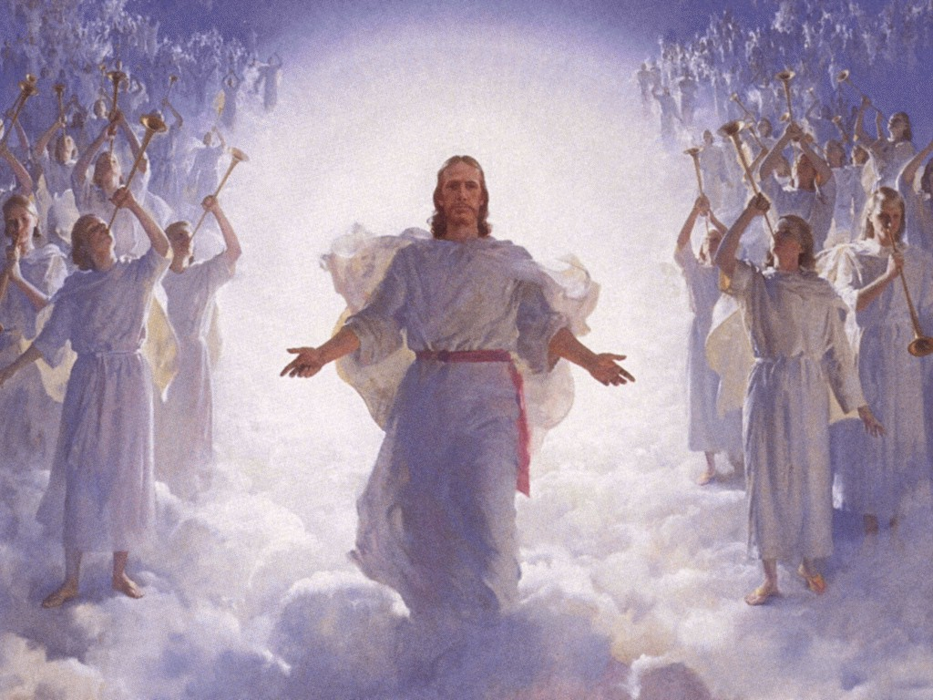
Jesus returns

Slide 49
BIBLE
OVERVIEW

